Slide 1
welcome
Exchange week 30 March -6 April

Slide 2
We will try to present our differences and our similarities

Slide 3
If we look close to the map, the only thing we can see is differences
Notes:
Our Nations as differently determind with different traditions and culture. We are not in the same positions, as well we know,
Unsere Nationen sind unterschiedlich durch unterschiedliche Traditionen und Kulturen bestimmt. Wir sind nicht in den gleichen Positionen, wie wir wissen,

Slide 4
But…
But obviously we are all in Europe: similarity
Some of you came from the North and others from the South. Difference
but you all landed in the South part of Europe, in a country known for centuries as Greece : Similarity

Slide 5
All of you for a week will be hosted in a different house and you will stay with a foreign family
You will be away of your own friends
but you will be with the same friend you had hosted in your own country. (Similarity)
but among other friends.(Similarity)

Slide 6
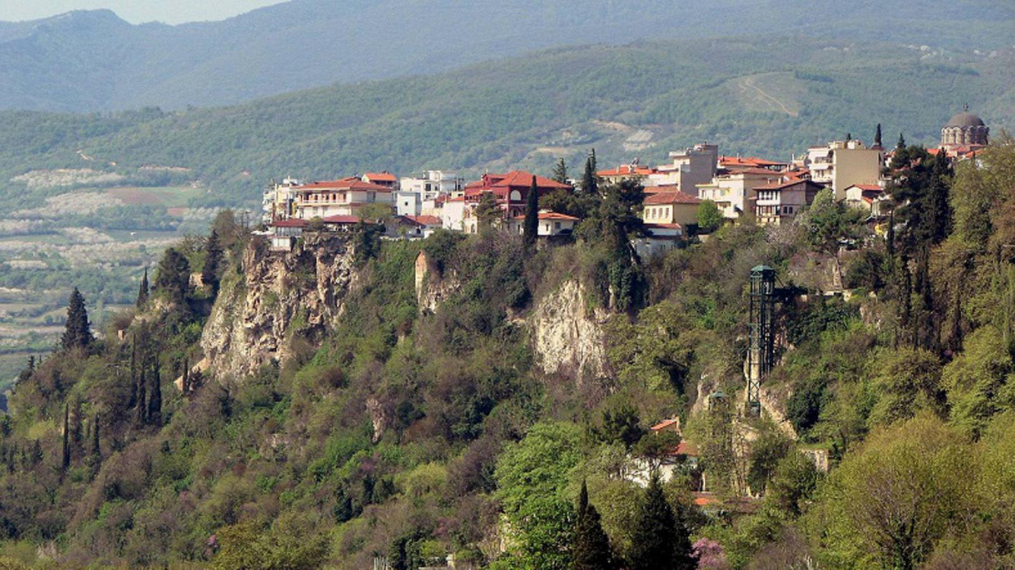
you have come in a town situated literally on a rock- something different and new for all of you.

Slide 7
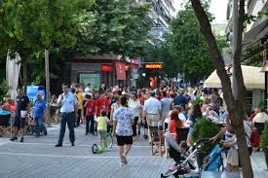
Steenwijk
But Edessa is as big as Steenwijk
Edessa

Slide 8
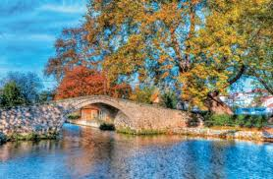
it has a river like Graz
Graz- Mur
Edessa –Edessaios

Slide 9
And because of its location the buildings look like human towers in Sant Pere de Ribes
Edessa
Human towers of Castellers

Slide 10
As you can see behind the surface -which of course is different- we are the same and share the same fears , dreams, problems, expectation because we are bond to live together in the same continent- Europe- the name is Greek but embraces all human who want to act and feel human and we are here to prove it , overcoming all
Stereotypes
Fears
Financial crisis
refugees
The others
Ourselves

Slide 11
Keep it in mind : we are closed in the same bubble
Notes:
but we are closed in the same bubble, in a glass bell,
aber wir sind in derselben Blase geschlossen, in einer Glasglocke,

